Slide 1
Language
Processing
System

Slide 2



Meet the Team:
Abdullah Faisal
Prince Saha
191-15-12967
191-15-12978
Bipro Roy
191-15-12976
Notes:
Photo by Yucel Moran on Unsplash
Photo by sean Kong on Unsplash
Photo by Caique Silva on Unsplash

Slide 3

Introduction
The computer is an intelligent combination of software and hardware. Hardware is simply a piece of mechanical equipment and its functions are being compiled by the relevant software. The hardware considers instructions as electronic charge, which is equivalent to the binary language in software programming. The binary language has only 0s and 1s. To enlighten, the hardware code has to be written in binary format, which is just a series of 0s and 1s. Writing such code would be an inconvenient and complicated task for computer programmers, so we write programs in a high-level language, which is Convenient for us to comprehend and memorize. These programs are then fed into a series of devices and operating system (OS) components to obtain the desired code that can be used by the machine. This is known as a language processing system.
Notes:
Please watch all videos above.

Slide 5
Cousins of Compilers
Preprocessors:
A program may be divided into modules stored under separate files. Preprocessor combines all such files.
preprocessor also expands short hands(macros)
Compiler : converts high level language into assembly or machine code.
Assemblers :
Compiler may produce assembly code instead of generating relocatable machine code directly.

Slide 6
Loaders and Linkers:
Large programs are often compiled in pieces, so the relocatable machine code may have to be linked together with other relocatable object files and library files.
Linker resolves external memory addresses, where the code in one file may refer to a location in another file.
The loader puts together all of the executable object files into memory for execution.

Slide 7

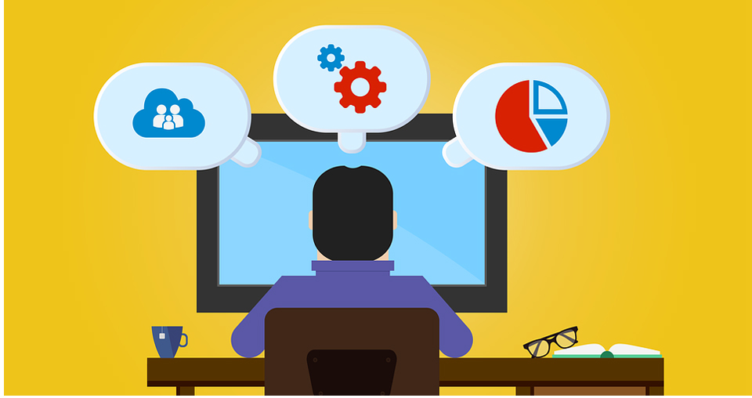
Language Processors
A translator inputs and then converts a source program into an object or target program.
Source program is written in a source language
A translators could be: Assembler, Compiler, Interpreter
Source program
(in assembly language) Object Program
( in machine language)
Assembler
Notes:
Photo by Markus Spiske on Unsplash

Slide 8
Language Processors
a compiler is a program that can read a program in one language the source language - and translate it into an equivalent program in another language - the target language;

Slide 9
Interpreter
An interpreter is another common kind of language processor. Instead of producing a target program as a translation, an interpreter appears to directly execute the operations specified in the source program on inputs supplied by the user
Source program
Interpreter
Output
Input
The machine-language target program produced by a compiler is usually much faster than an interpreter at mapping inputs to outputs .
An interpreter, however, can usually give better error diagnostics than a compiler, because it executes the source program statement by statement.
Notes:
Photo by Martin Adams on Unsplash

Slide 10
Overview of Compilers
Compiler: translates a source program written in a High-Level Language (HLL) such as Pascal, C++ into computer’s machine language (Low-Level Language (LLL)).
* The time of conversion from source program into object program is called compile time
* The object program is executed at run time
Interpreter: processes the source program and data at the same time (at run time).

Slide 11
Compilers and Interpreters
Why Interpretation:
Dynamic execution: modification or addition to user programs as execution proceeds.
Dynamic data type: type of object may change at runtime
Better diagnostics

Slide 12
Compilation Process:
Data
Source
program
Compiler
Object
Program
Excuting
Computer
Results
Runtime
Interpretion Process:
Source
Program
Interpreter
Results

Slide 13
Thank You

